Slide 1
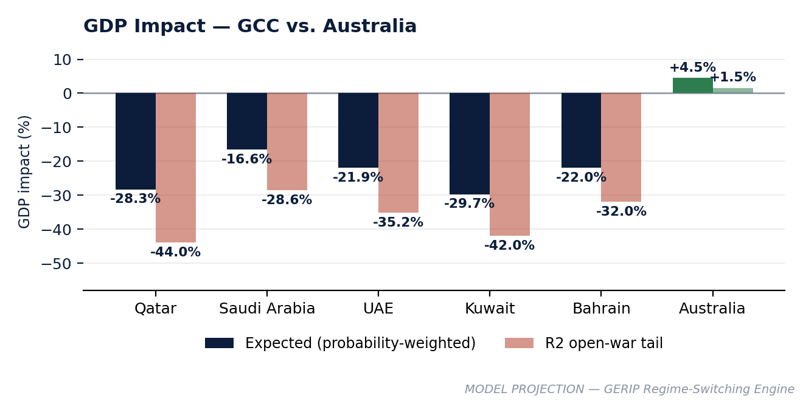
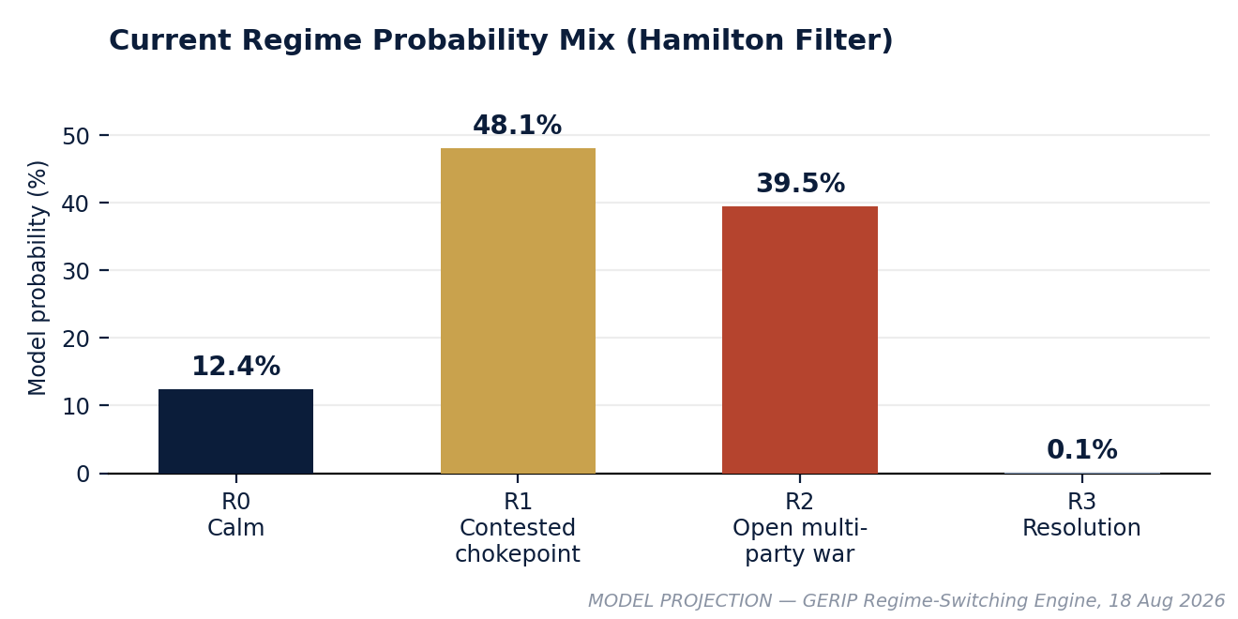
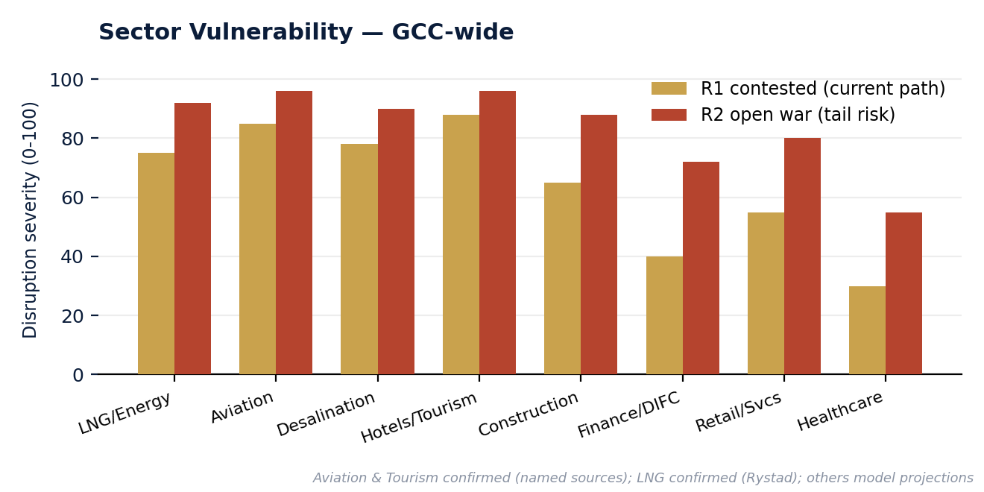
ECONNOVA INSTITUTE | GERIP INTELLIGENCE
GERIP WEEKLY
Issue 02 · Financial Services — GCC Capital & Institutional Resilience · Week of 18 August 2026
SECTOR SPOTLIGHT: This week's largest mover is Aviation & Tourism (Issue 01). Financial Services carries the lowest disruption severity of any GCC sector under both regime paths — GERIP's model finds zero DIFC payment defaults through the conflict to date.
MODEL PROJECTION — GERIP Regime-Switching Engine & Labour Market Module
EMPLOYMENT Zero defaults to date
WAGES Data limited this issue
NATIONALIZATION Not modelled this issue
GDP EXPOSURE Qatar −28.3% (expected)
Strongest resilience reading of any tracked sector.
Sector-specific wage series planned for a future issue.
Tracked separately on the live dashboard.
Australia is the only market showing a positive impact.
Full regional breakdown, 8-week forecasts & exposure screening → GERIP Advanced / Full
econnovainstitute.com
Strategic advisory & scenario briefings → ceo@econnovainstitute.com

