Slide 1
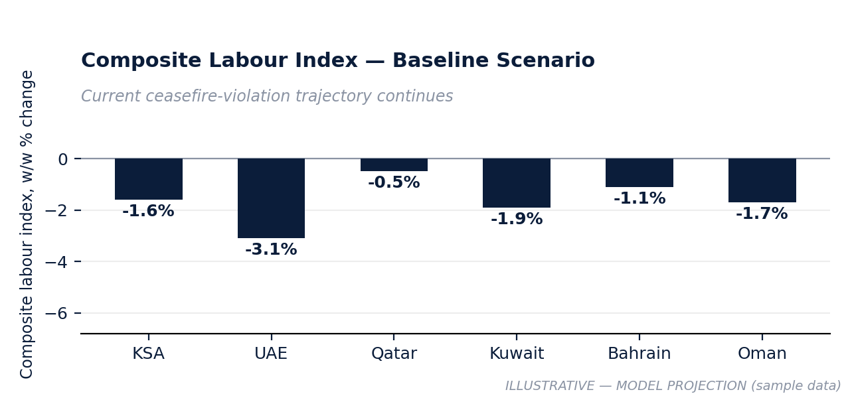
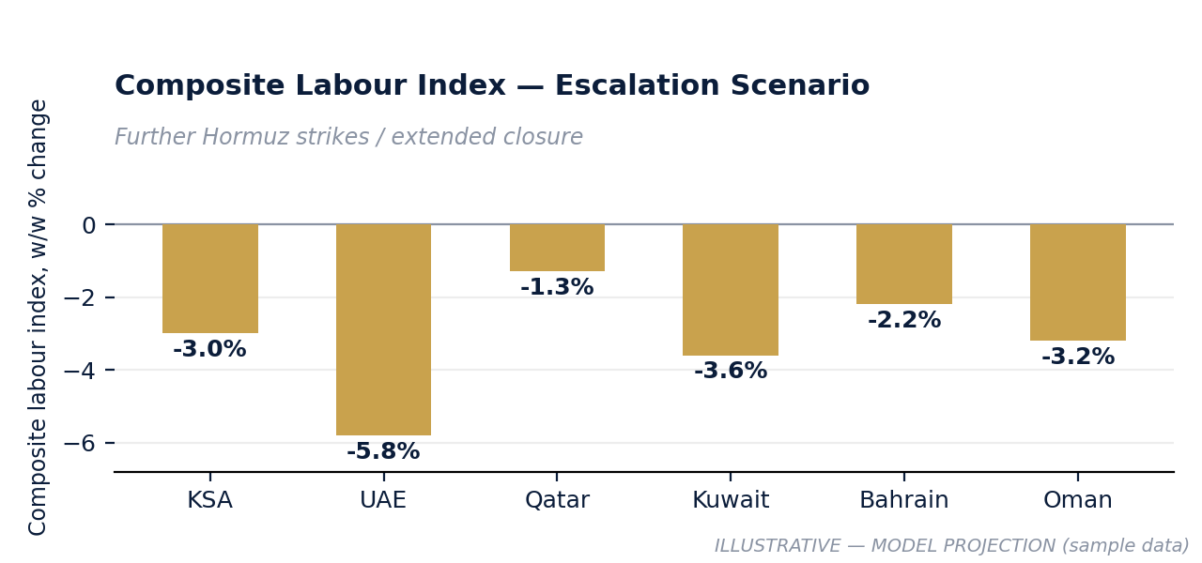
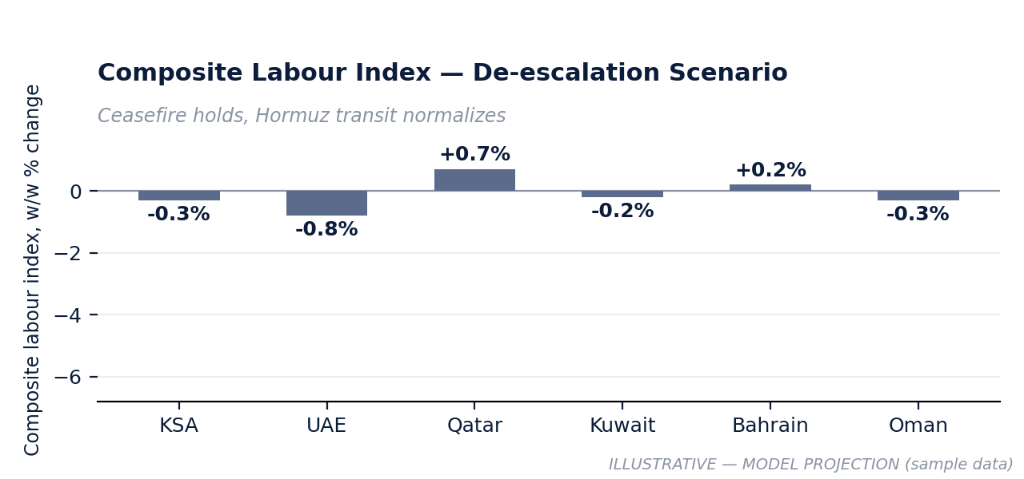
ECONNOVA INSTITUTE | GERIP INTELLIGENCE
GERIP WEEKLY
Sample Issue · Logistics & Maritime Transport · Week of [DATE]
THIS WEEK'S SIGNAL: Logistics & Maritime employment down 1.8% GCC-wide (UAE −3.4%) as Hormuz disruption compresses freight throughput, even as sector wages continue to rise.
ILLUSTRATIVE — MODEL PROJECTION (sample data)
EMPLOYMENT −1.8% w/w
WAGES +0.5pp vs GCC avg
NATIONALIZATION Mixed
MIGRATION Net outflow: UAE, Kuwait
Port/freight headcount down across 5 of 6 markets.
Shipping wages rise despite falling headcount.
UAE Emiratization slipping in freight-forwarding.
Qatar shows marginal net inflow (LNG-linked).
Full regional breakdown, 8-week forecasts & exposure screening → GERIP Advanced / Full
econnovainstitute.com
Strategic advisory & scenario briefings → ceo@econnovainstitute.com

